Slide 1
Lecture 13-15
Data Structures
Presented By:
Marina Gul

Slide 2
Topics to be covered
Recap of the previous lecture
Analysis of algorithms
Complexity of algorithm
Time complexity
Space complexity
Big O Notation
Best-case analysis
Worst-case analysis
Average-case analysis

Slide 3
Analysis of Algorithm
To go from the city “A” to city “B”, there can be many ways of accomplishing this: by flight, by bus, by train, and also by bicycle.
Depending on the availability and convenience, we choose the one that suits us. • Similarly, in computer science, multiple algorithms are available for solving the same problem (for example, a sorting problem has many algorithms, like insertion sort, selection sort, quick sort, and many more).
Algorithm analysis helps us to determine which algorithm is most efficient in terms of time and space consumed

Slide 4
Why study algorithm Analysis?
We want to measure how “good” an algorithm or data structure is.
We want to do it agnostic to the underlying hardware, processor/memory speed.
To classify some data structures and algorithms as “good,” we must have precise ways of analyzing them.
We would like to focus on the relationship between the running time of an algorithm and the size of its input

Slide 5
Given two algorithms for a task, how do we find out which one is better?
One naive way of doing this is – to implement both the algorithms and run the two programs on your computer for different inputs and see which one takes less time. There are many problems with this approach for the analysis of algorithms.
It might be possible that for some inputs, the first algorithm performs better than the second. And for some inputs second performs better.
It might also be possible that for some inputs, the first algorithm performs better on one machine, and the second works better on another machine for some other inputs.

Slide 6
Finding the runtime of an algorithm in JAVA
long startTime = System.nanoTime(); //record the starting time
run algorithm
long endTime = System.nanoTime(); //record the ending time
long totalTime = endTime - startTime;//compute the elapsed time

Slide 7
Use a Theoretical Approach
Based on high-level description of the algorithms, rather than language dependent implementations
Makes possible an evaluation of the algorithms that is independent of the hardware and software environments
→ Generality

Slide 8

Algorithm Efficiency
A metric to compare/judge the performance of algorithms
If the code/function has sequential control flow that is it is linear (no loops), then it’s efficiency is a function of n i.e.
$$Efficiency=f(n)$$

Slide 9

Efficiency of Linear Loops
i=1
n=100
loop (i <= n)
//code
i = i + 1
end loop
The above code runs at most n times hence
0.5 1 1.5 2 2.5 3 3.5 4
Efficiency f(n)
No. of Statements (n)
$$Efficiency=n$$

Slide 10

Efficiency of Linear Loops
i=1
n=100
loop (i <= n)
//… code
i = i + 2
end loop
The above code runs at most n/2 times hence
The efficiency is still a linear function
0.25 0.5 0.75 1 1.25 1.5 1.75 2
Efficiency f(n)
No. of Statements (n)
$$Efficiency=n/2$$

Slide 11

Efficiency of Logarithmic Loop
i=1
n=100
loop (i <= n)
//… code
i = i * 2 or
i = i / 2
end loop
$$Efficiency=log2n$$

Slide 12
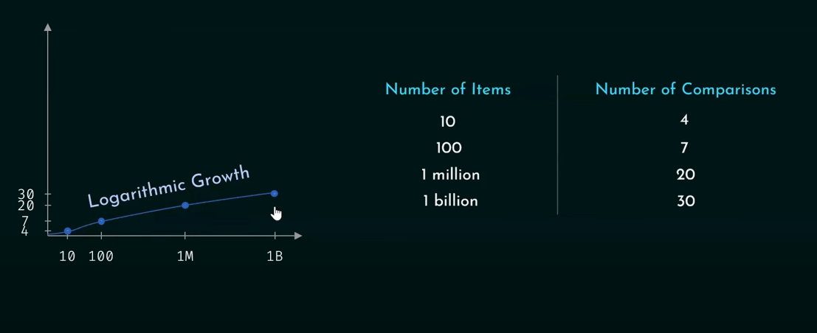
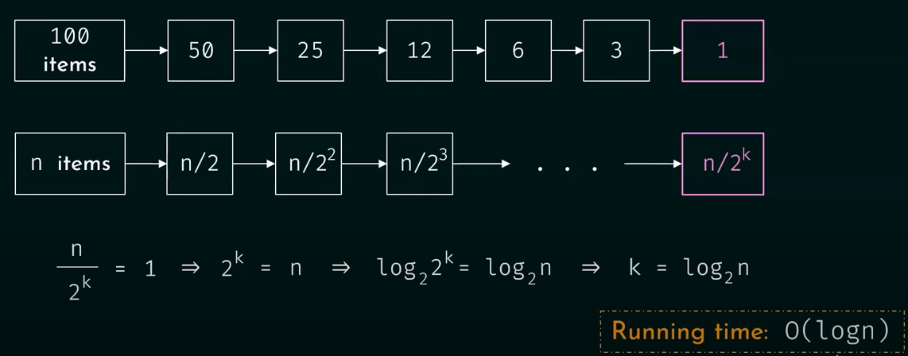
Logarithmic Growth

Slide 13


Efficiency of Quadratic/Nested Loop
i=1, j=1, n=100, m=100
loop (i <= n)
loop (j <= m)
//… code
j = j + 1
end loop
i = i + 1
end loop
$$Efficiency=n∗m$$
The above code runs n*m times hence
Generalized
$$Efficiency=n2$$

Slide 14


Linear Logarithmic Loop
i=1, j=1, n=100, m=100
loop (i <= n)
loop (j <= m)
//… code
j = j * 2
end loop
i = i + 1
end loop
$$Efficiency=nlog2m$$
The above loop runs n*log₂m times
Generalized
$$Efficiency=nlog2n$$

Slide 15
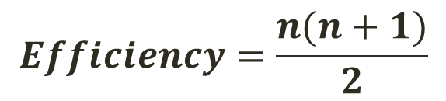
Dependent Quadratic
i=1, n=100
loop (i <= n)
j=1
loop (j <= i)
//… code
j = j + 1
end loop
i = i + 1
end loop
Outer loop runs n times
Inner loop runs (n+1)/2 times (see next slide)
$$Efficiency=\frac{n(n+1)}{2}$$

Slide 16
Dependent Quadratic - Inner loop
i | j | Total j iterations | Total Times j loop runs
1 | 1 | 1 | 1+2+3+4+5+6+7+8+9+10=55 Average: (1+10)/2=5.5 Average Generalized: (n+1)/2
2 | 1,2 | 2
3 | 1,2,3 | 3
4 | 1,2,3,4 | 4
5 | 1,2,…,5 | 5
6 | 1,2,…,6 | 6
7 | 1,2,…,7 | 7
8 | 1,2,…,8 | 8
9 | 1,2,…,9 | 9
10 | 1,...,10 | 10

Slide 17
Algorithm Complexity
Two ways to measure
Time complexity
How much time is required for an algorithm
Space complexity
How much space is required for an algorithm
Usually we work with estimates rather than exact values

Slide 18
Time Complexity
More important as compared to space complexity
It is the process of determining how processing time increases as the size of the problem (input size) increases.
3-4GHz. processors on the market
still …
researchers estimate that the computation of various transformations for 1 single DNA chain for one single protein on 1 TerraHz. computer would take about 1 year to run to completion

Slide 19
Running time
Suppose the program includes an if-else statement that may execute or not: → variable running time
Typically algorithms are measured by their worst case performance

Slide 20
Asymptotic Notation
Asymptotic notation is a way to describe the running time or space complexity of an algorithm based on the input size. It is commonly used in complexity analysis to describe how an algorithm performs as the size of the input grows.
It provides a high-level understanding of the algorithm's efficiency by ignoring constant factors and lower-order terms, focusing instead on the most significant terms

Slide 21
“Relatives” of Big-Oh
The three most commonly used notations are Big O, Omega, and Theta.
O (f(n)): Big O – asymptotic upper bound or worst-case complexity
“Relatives” of the Big-Oh
Ω (f(n)): Big Omega – asymptotic lower bound or best-case complexity
Θ (f(n)): Big Theta – asymptotic tight bound or average-case complexity

Slide 22
How do you find the Big O value?
Can be derived from f(n) as follows:
For each term of f(n), set the coefficient to 1
Keep the largest term in the function and discard others.
Terms are ranked from lowest (left) to highest (right)
log₂n n nlog₂n n² n³ … n^{k} 2^{n} n!
Fastest
Slowest

Slide 23
Example
Calculate Big O notation for dependent quadratic loop with efficiency
f(n)=n(n+1)/2

Slide 24
Example
Calculate Big O notation for dependent quadratic loop with efficiency f(n)=n(n+1)/2
Step 1: First expand all terms: n²/2 + n/2
Step 2: Remove coefficients: n² + n
Step 3: Take the bigger term: n²
So asymptotic upper bound: O(n²)

Slide 25
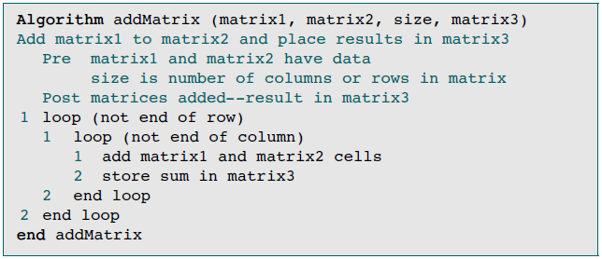
Example
Matrix addition asymptotic upper bound O(n²)

Slide 26
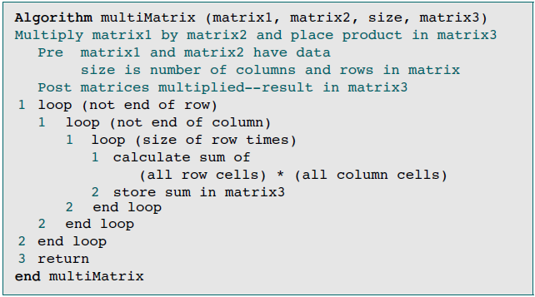
Example
Matrix Multiplication asymptotic upper bound: O(n³)

Slide 27
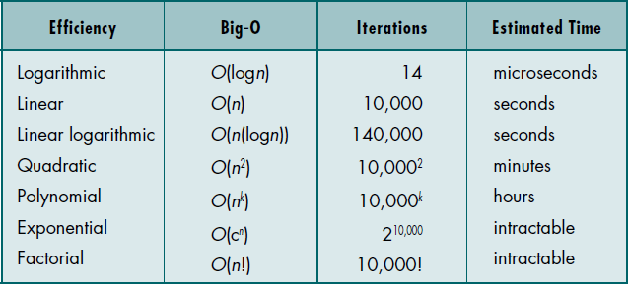
Standard Measures of Efficiency
Scientists have identified the following seven categories of algorithm efficiencies (n=10,000)

Slide 28
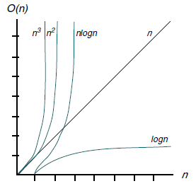
Plot of Efficiency Measures

Slide 29
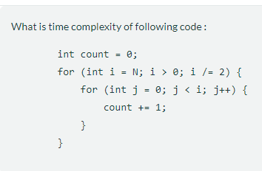
Task 01

Slide 30
space Complexity
The space Complexity of an algorithm is the total space taken by the algorithm with respect to the input size. Space complexity includes both Auxiliary space and space used by input.
**Auxiliary Space is the extra space or temporary space used by an algorithm.
Examples
If an algorithm needs an array of size n, its space complexity if O(n)
If an algorithms needs a matrix of size n*n, its space complexity is O(n²)

Slide 31
Example
Calling function B in another function A has space complexity of O(1)
Why?
Because each call to add does not exist simultaneously on stack
calc_pair_sum(n){ add(a, b){
sum = 0 return a+b}
for i in range(n):
sum += add(i, i+1)
return sum }

Slide 32
Example
Recursive function calls have space complexity of O(n)
Why?
Because each recursion call will exist simultaneously on the stack consuming stack memory
Power(x, n){
if n==0:
return 1
else
return x*Power(x, n-1)
}

Slide 33
Example
What is the space complexity of the following code snippet?
a = 10
b = 20
for i in range(N):
a = a + 10
for j in range(M):
b = b + 10
O(1)

Slide 34
Example
What is the time complexity of the following code snippet?
a = 10
b = 20
for i in range(N):
a = a + 10
for j in range(M):
b = b + 10
O(N+M)

Slide 35
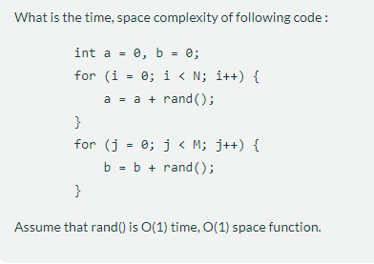
Task 02

Slide 36
Recap of the Lecture
Time Complexity is the time taken by an algorithm/program to run as a function of the length of the input.
Space Complexity is the total amount of memory used by an algorithm to run.
For modern hardware, it is less important to reduce your space complexity as compared to the time complexity.

